Slide 1

JUnit
From : Practical Test driven development for Java Programmers(Lynda)

Slide 2
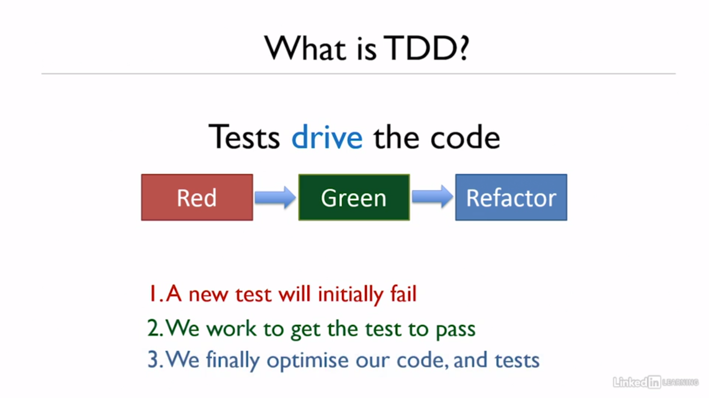

Slide 3
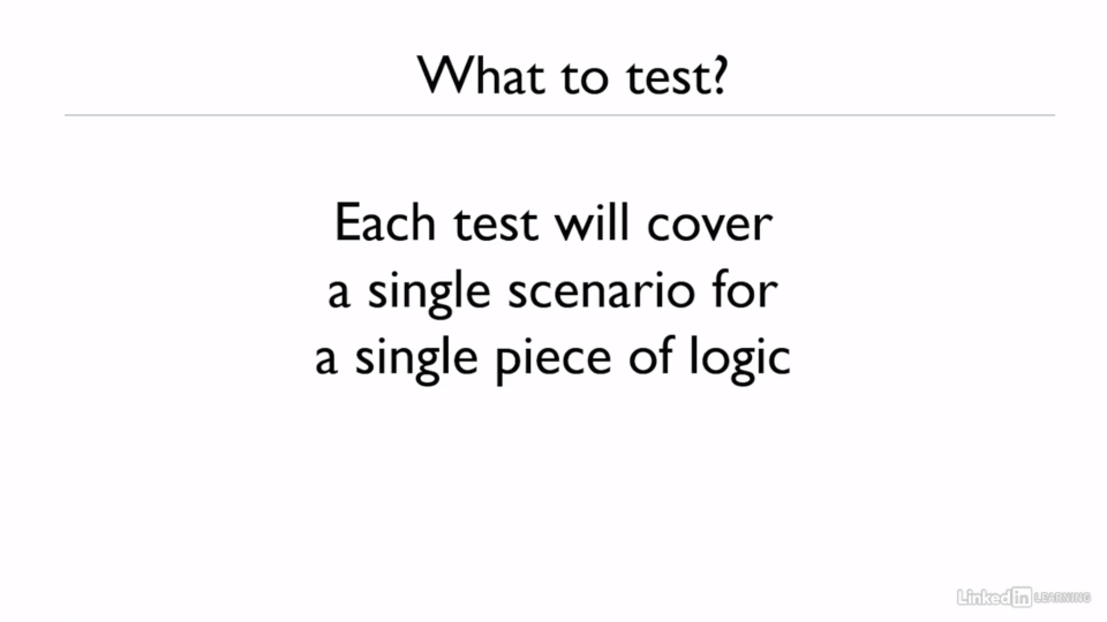

Slide 4
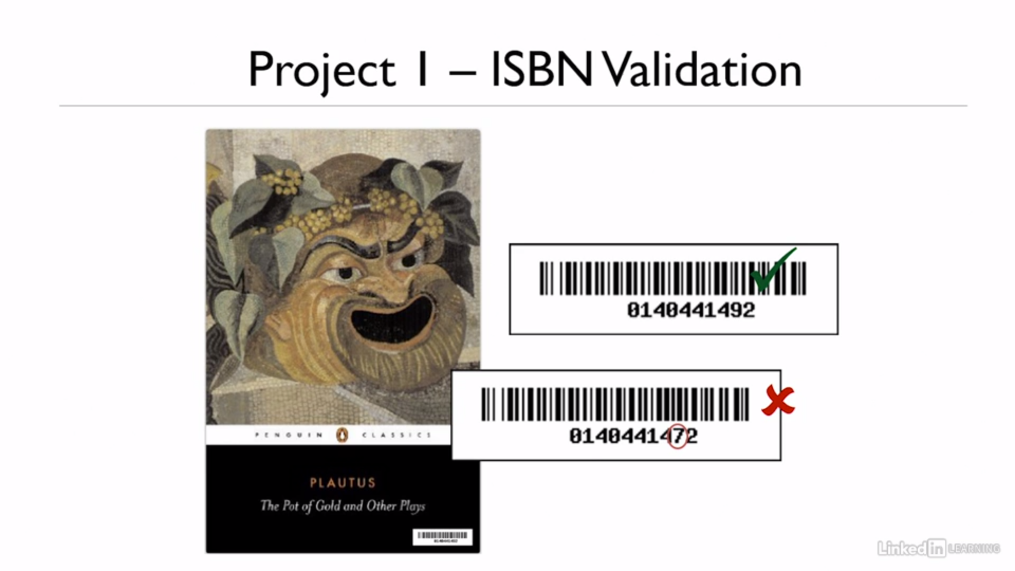

Slide 5
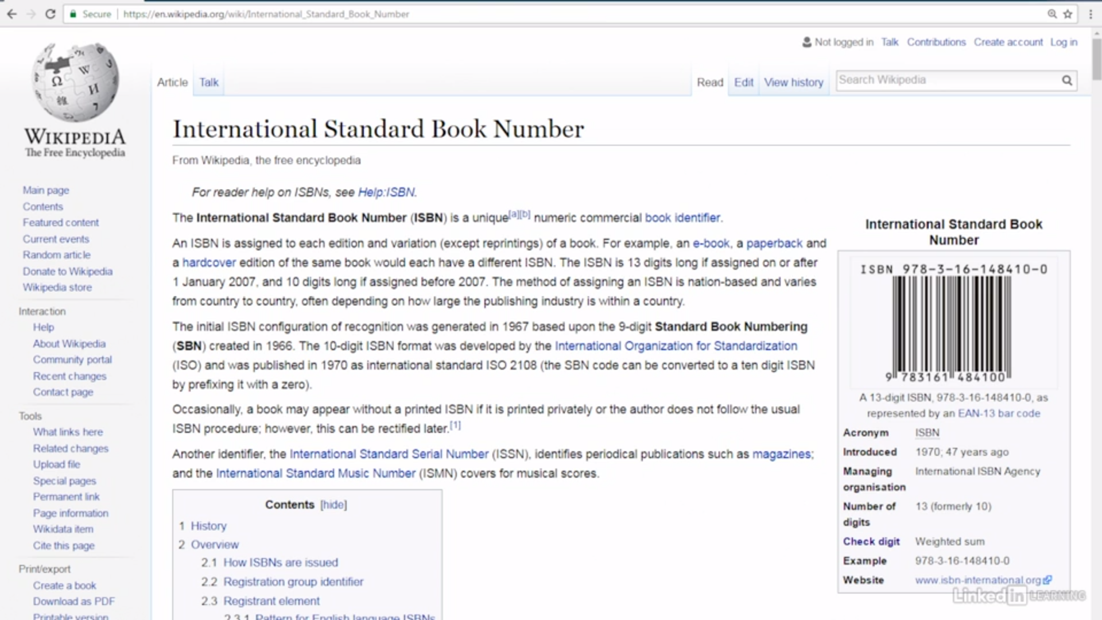

Slide 6
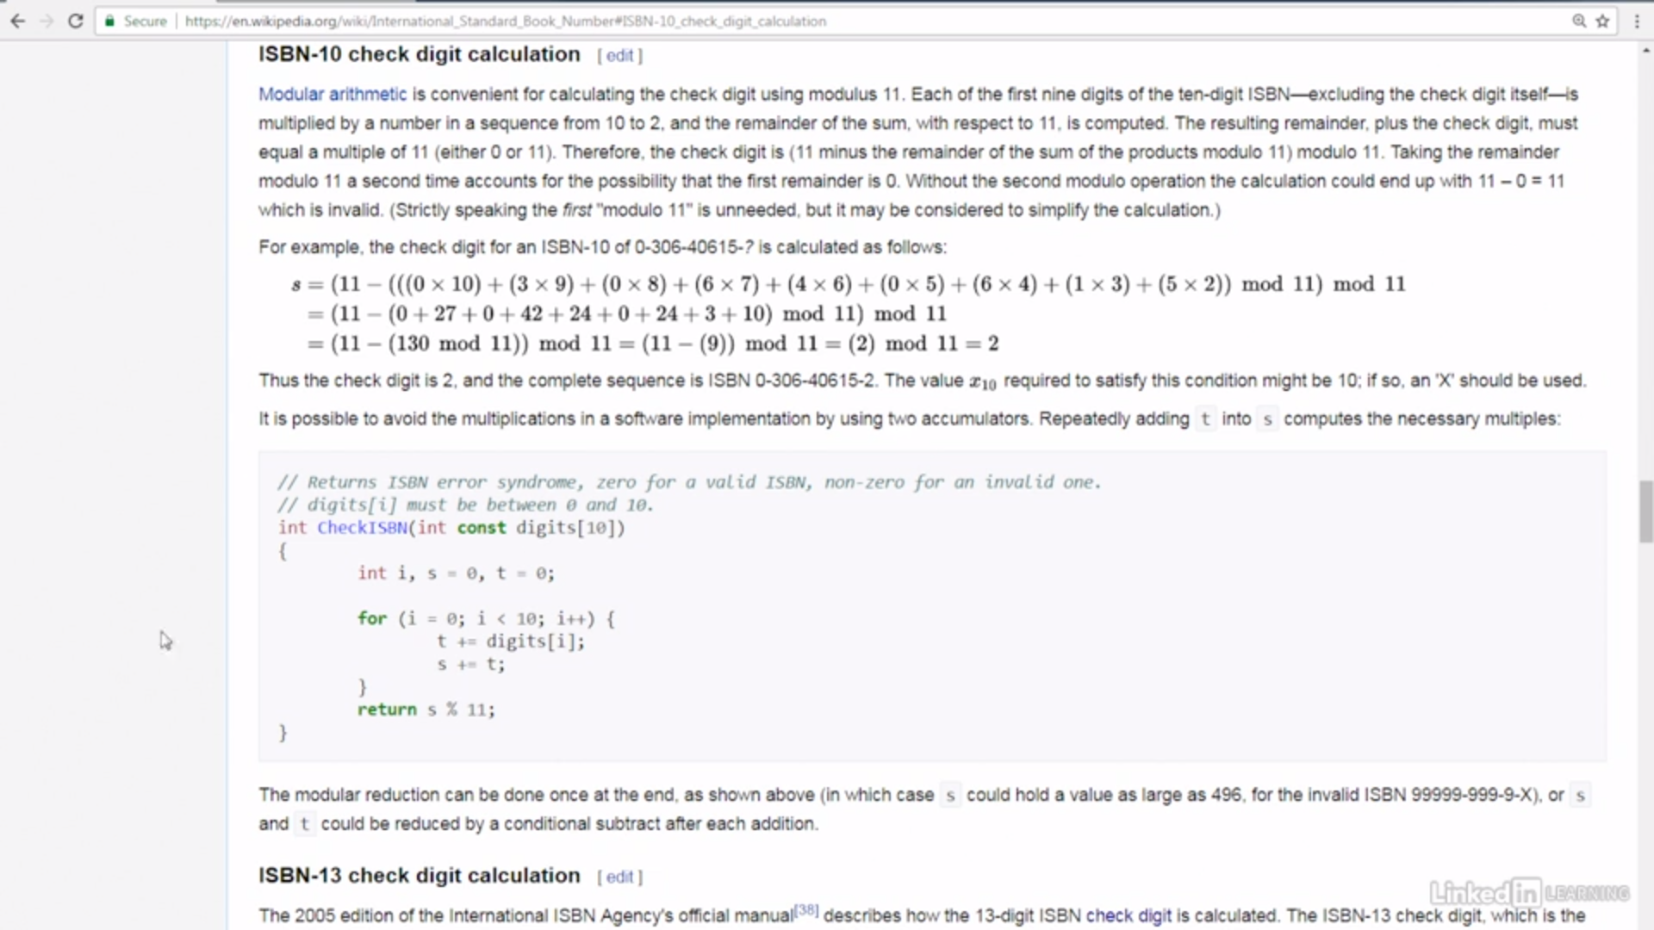

Slide 7
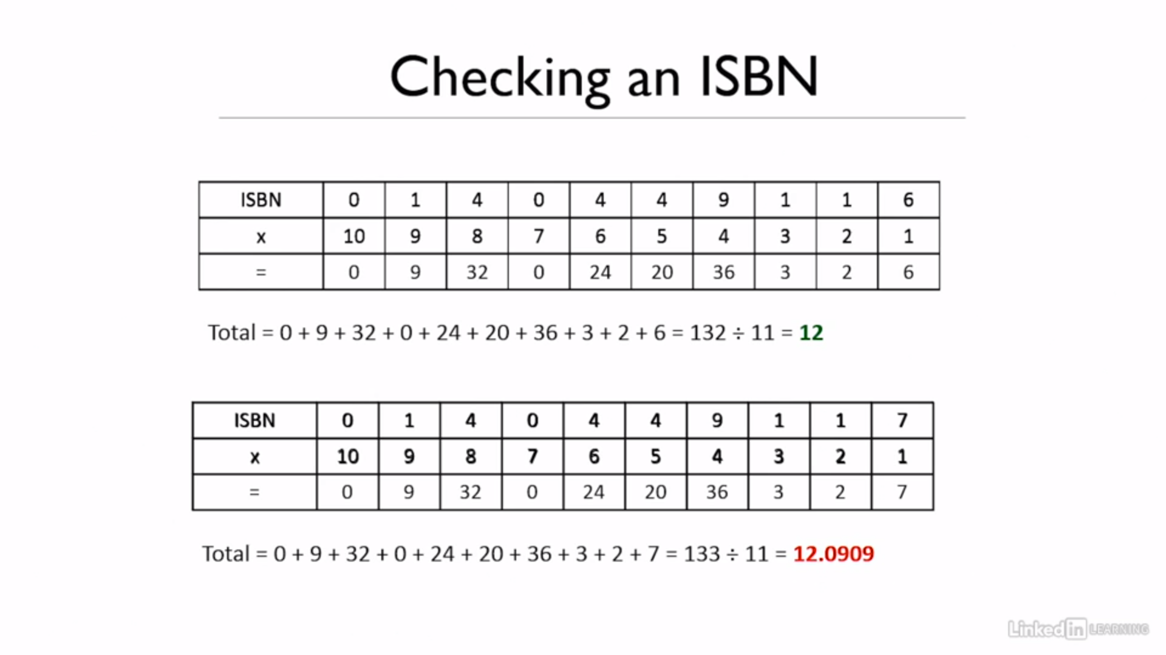

Slide 8
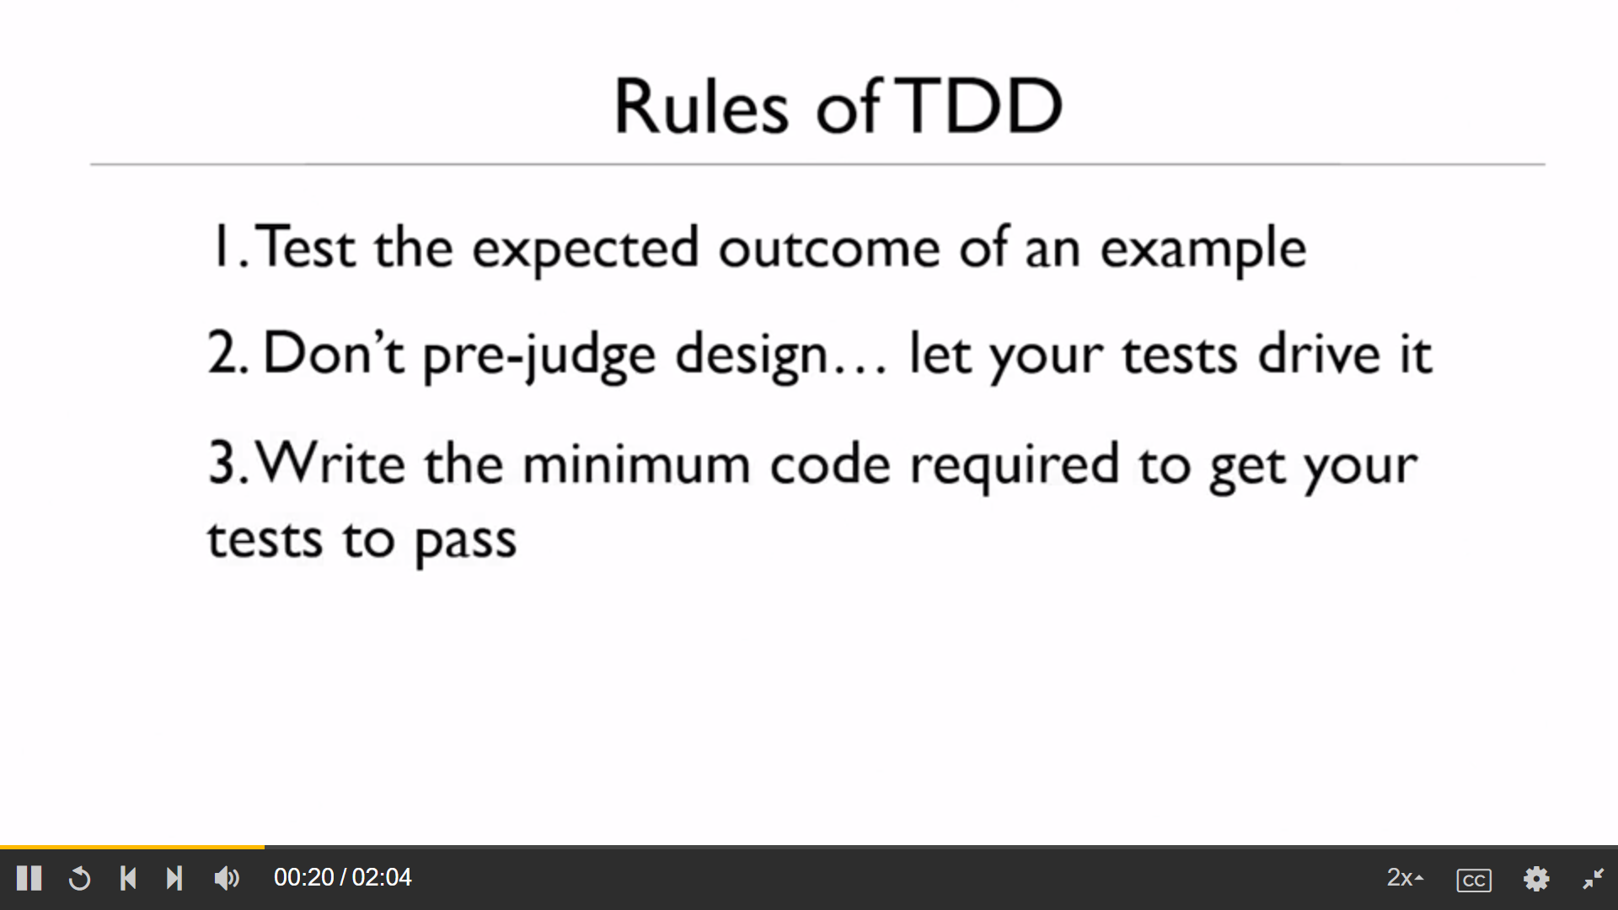

Slide 9
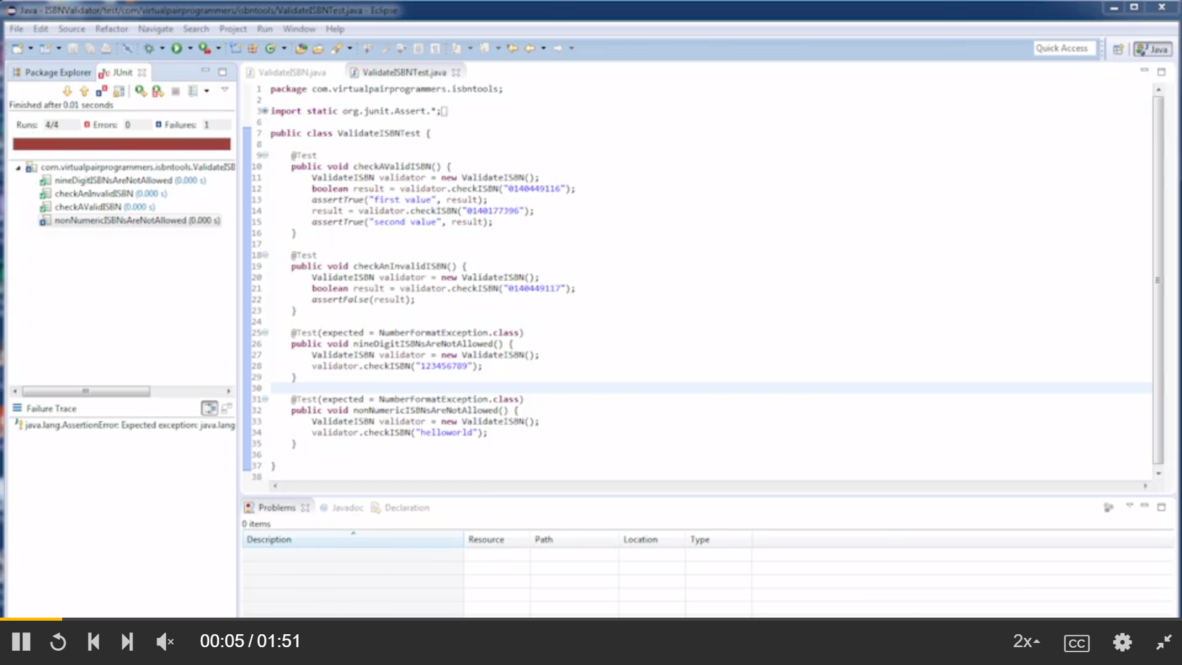

Slide 10
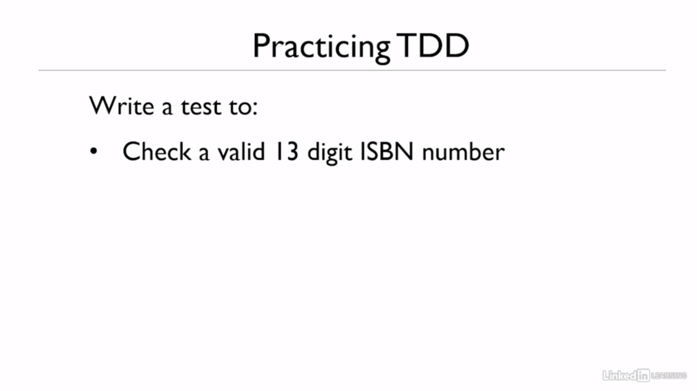

Slide 11
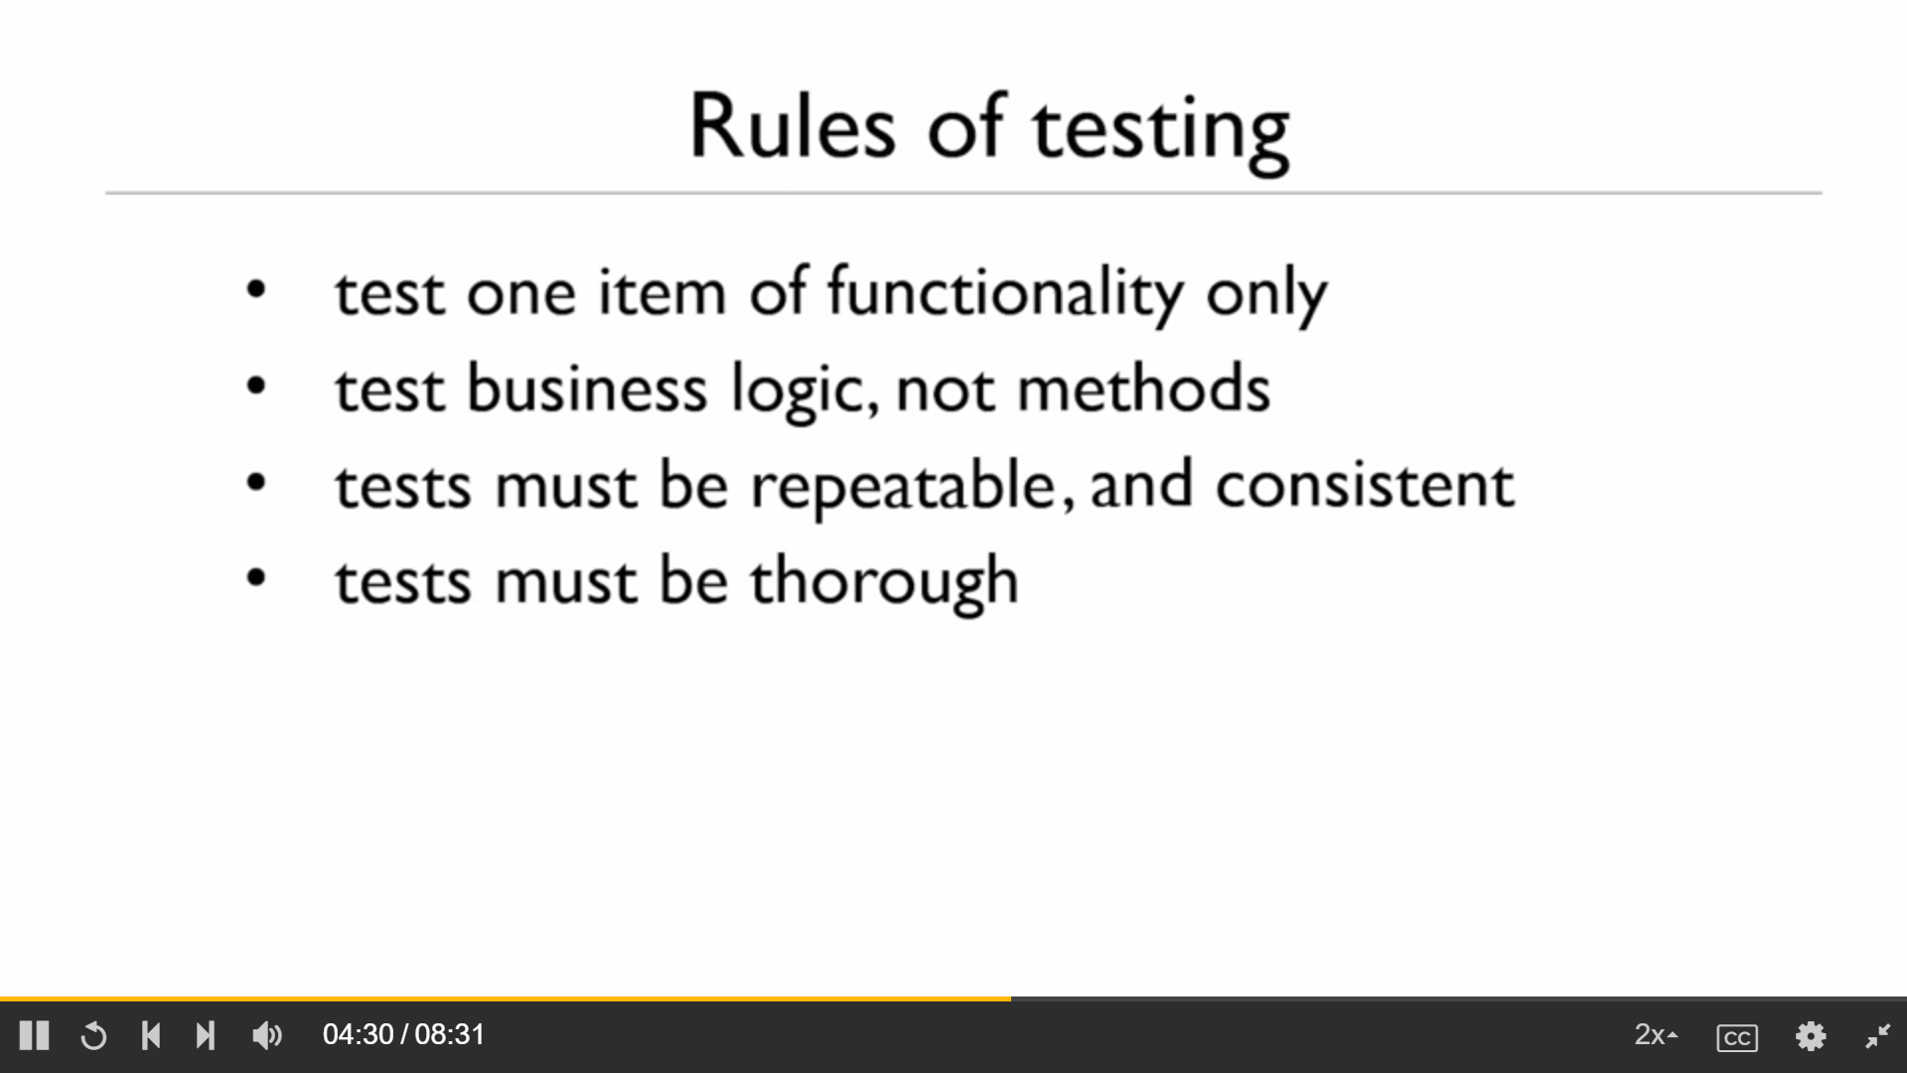

Slide 12
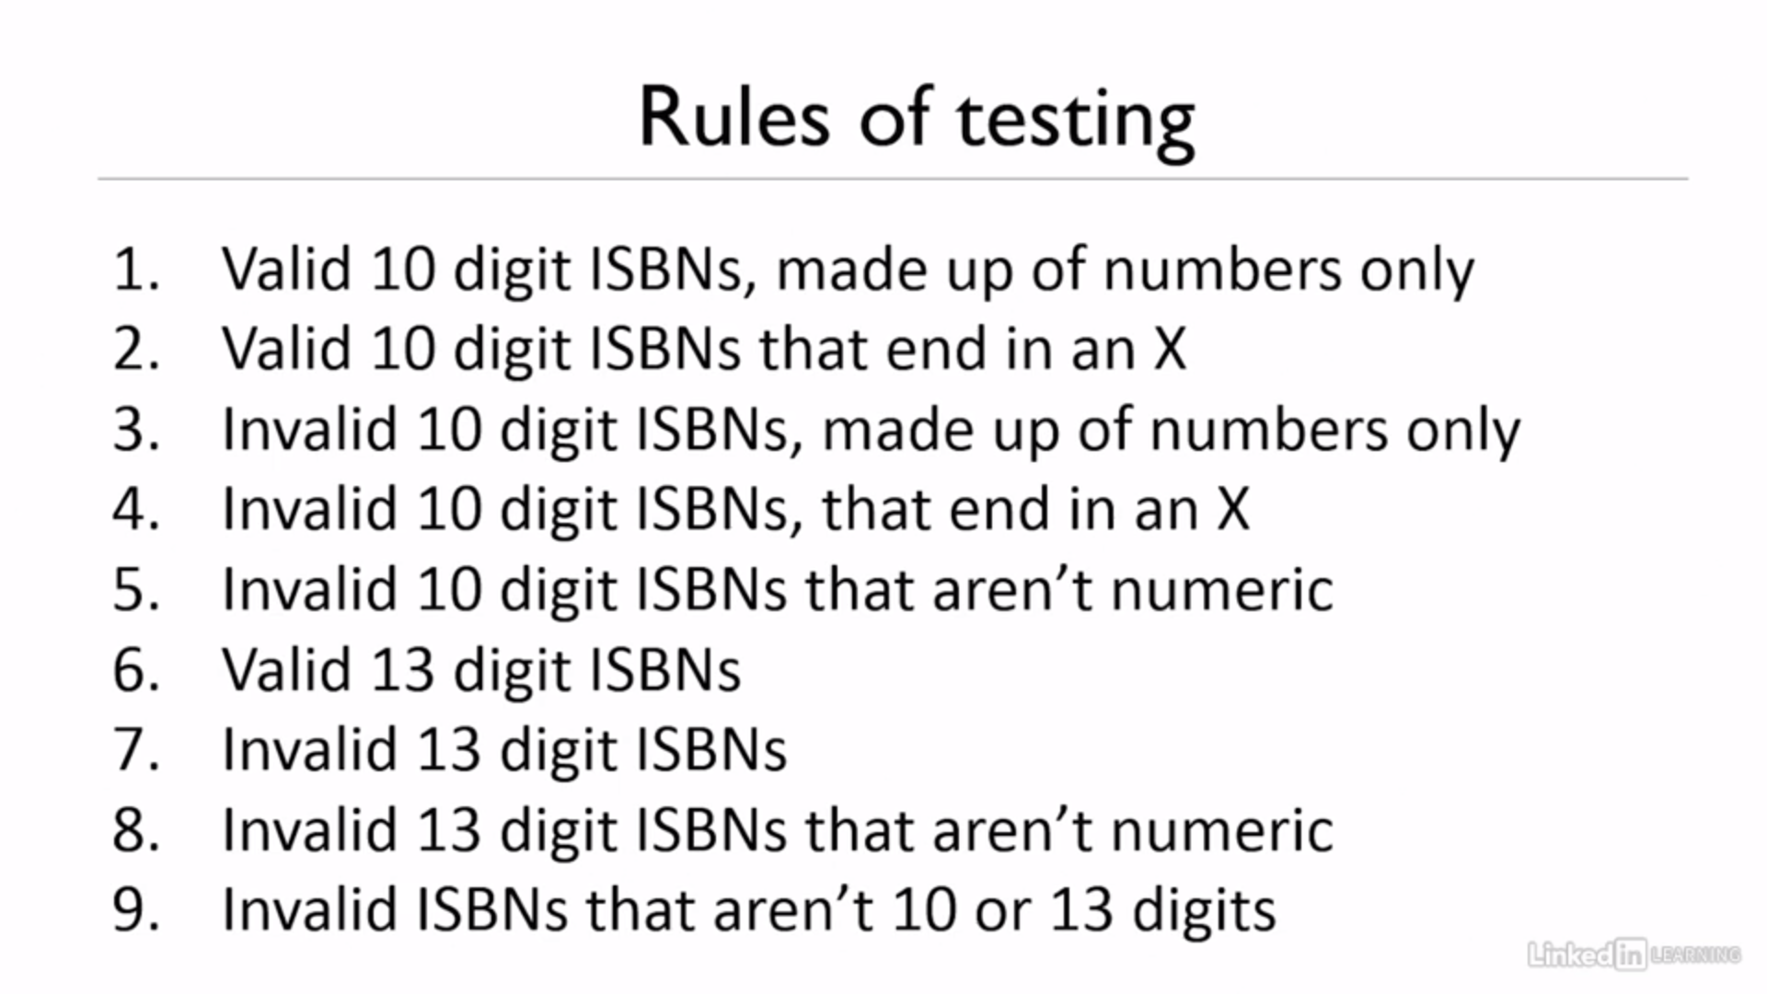

Slide 13
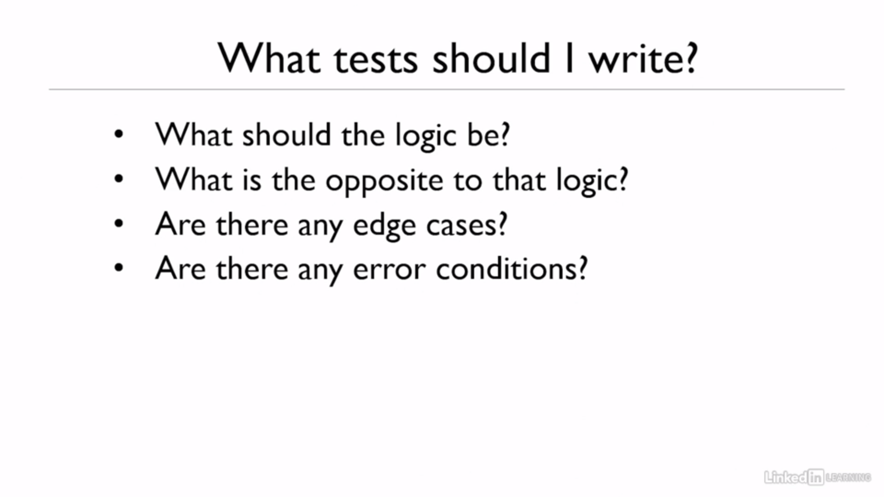

Slide 14
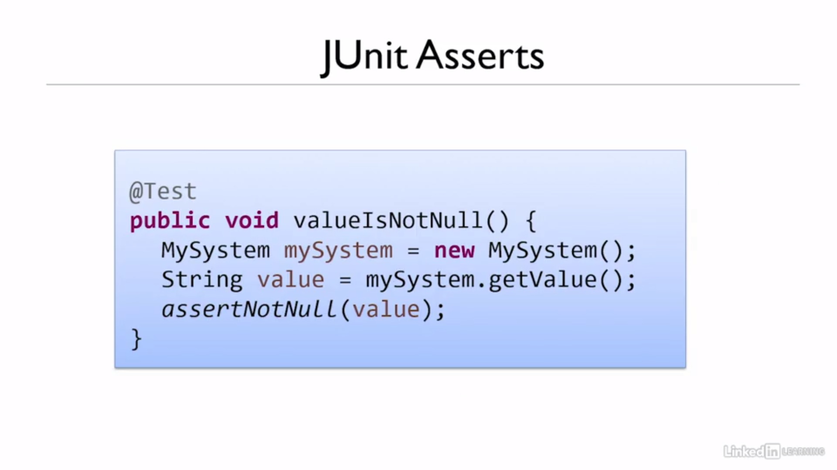

Slide 15
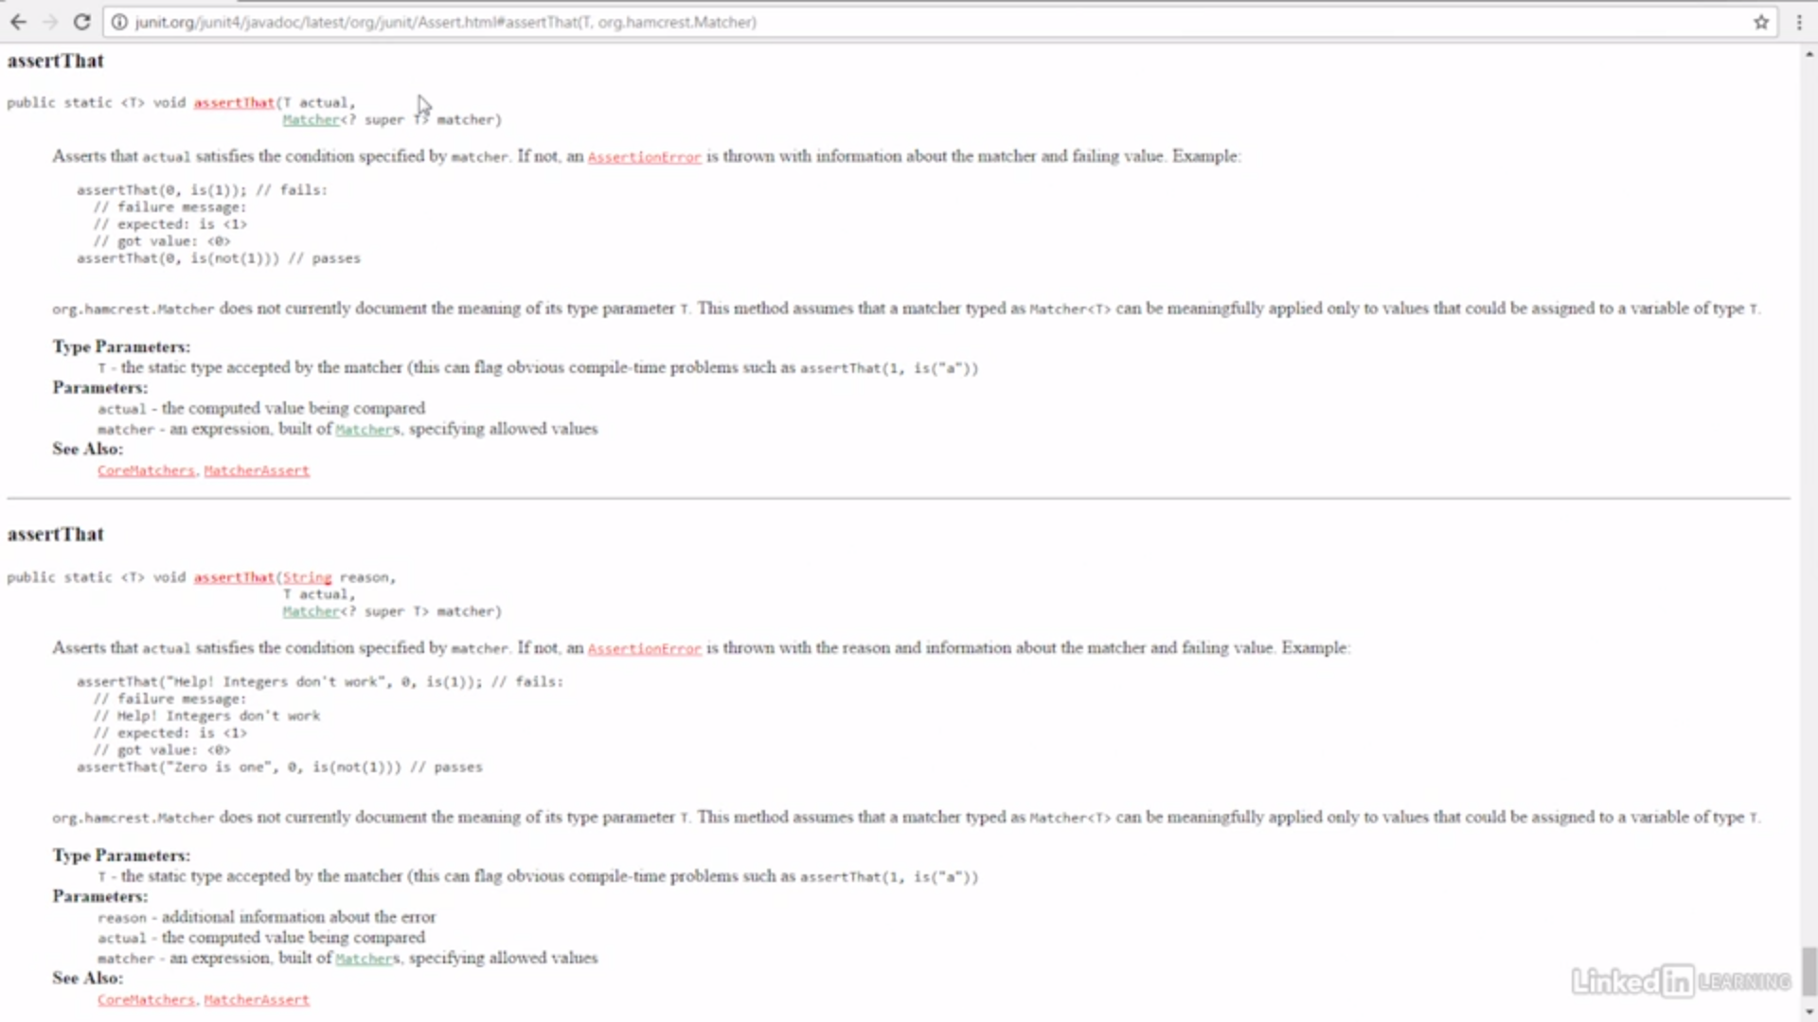

Slide 16
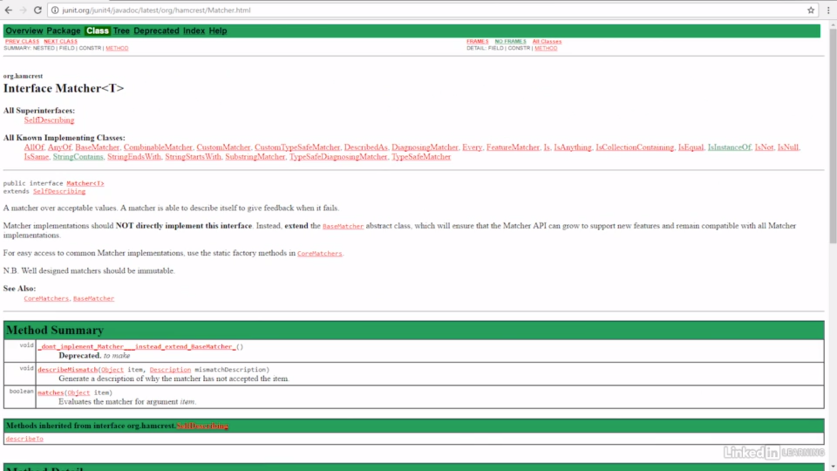

Slide 17
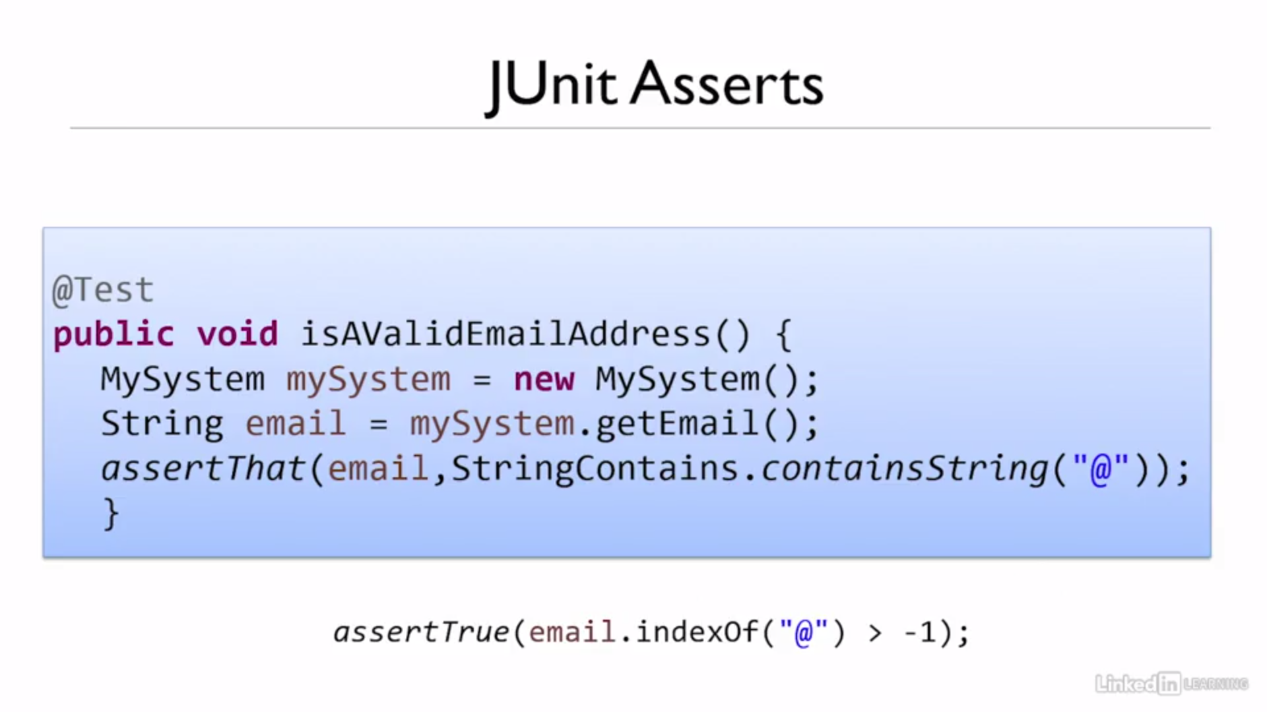

Slide 18
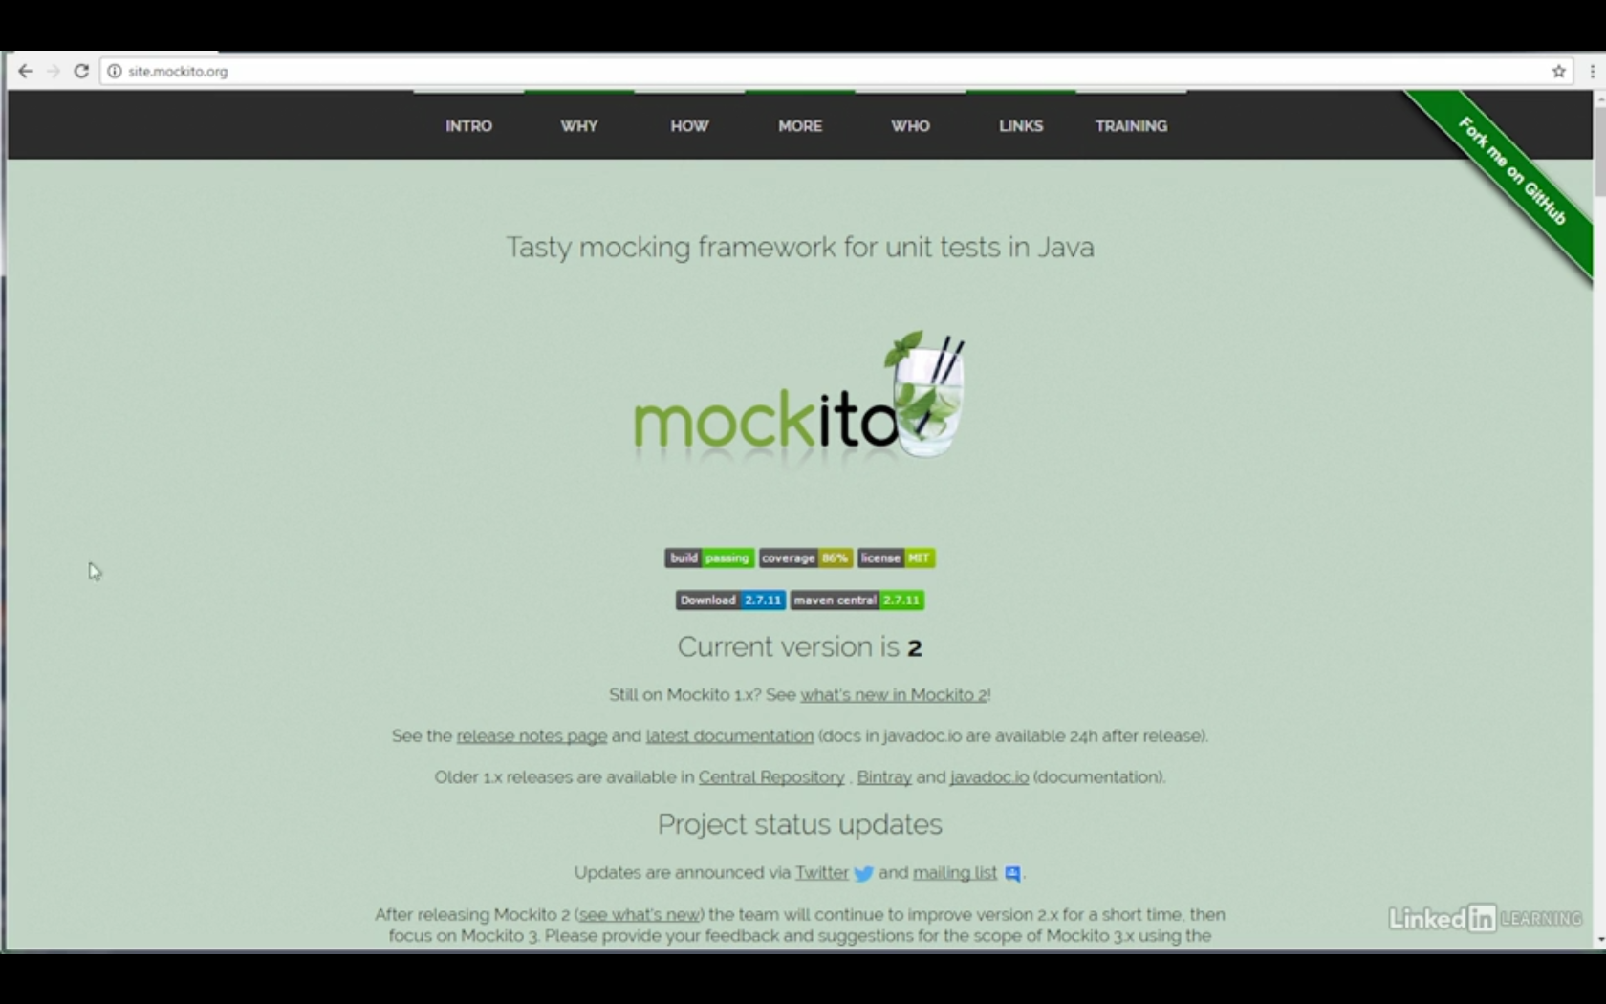

Slide 19
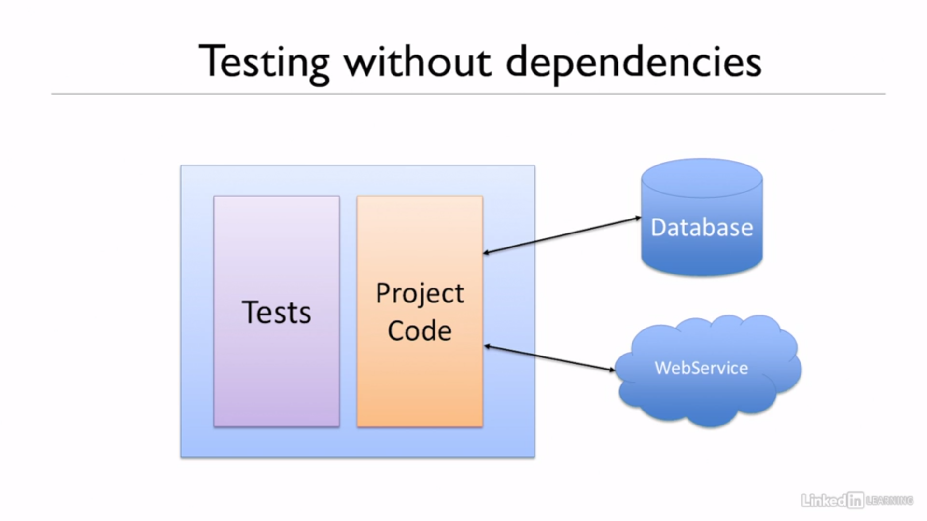

Slide 20
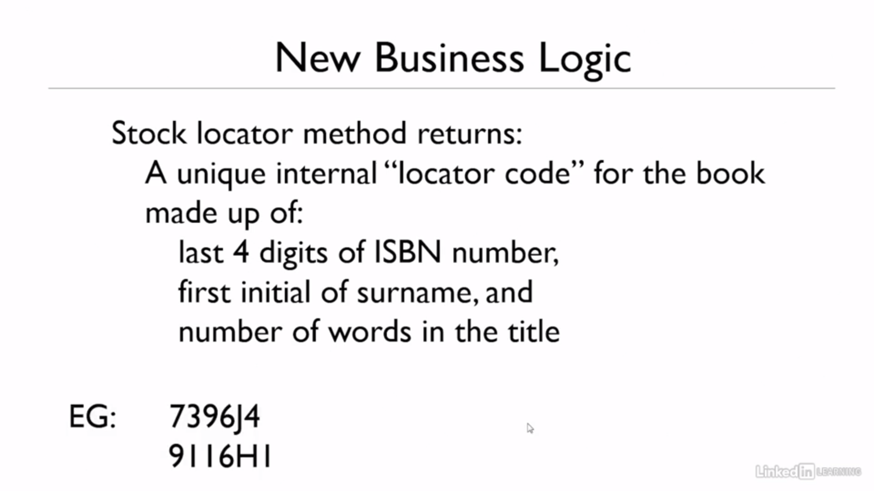

Slide 21
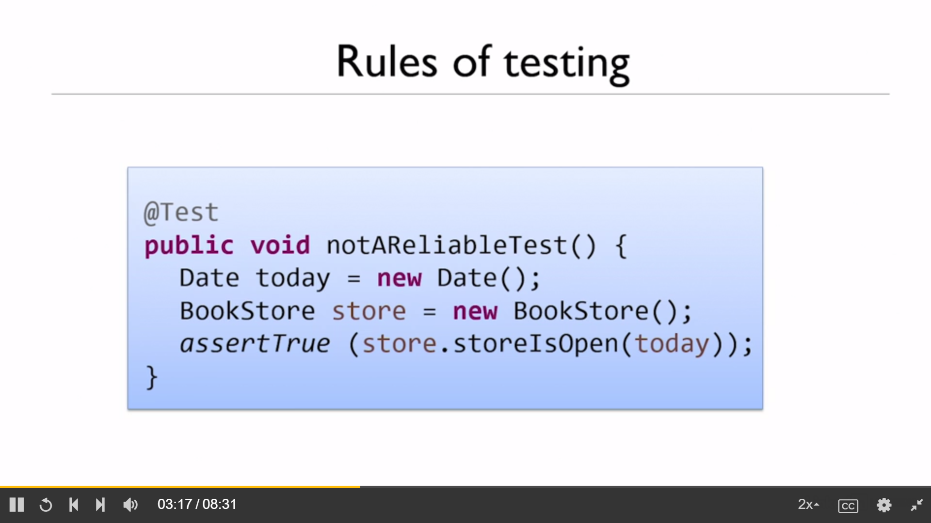

Slide 22
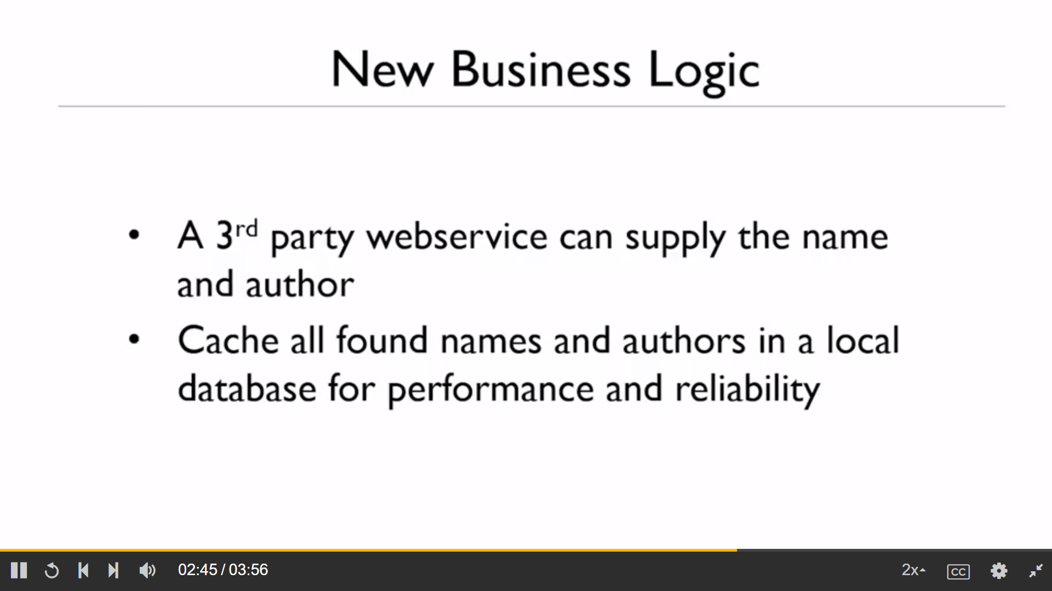

Slide 23
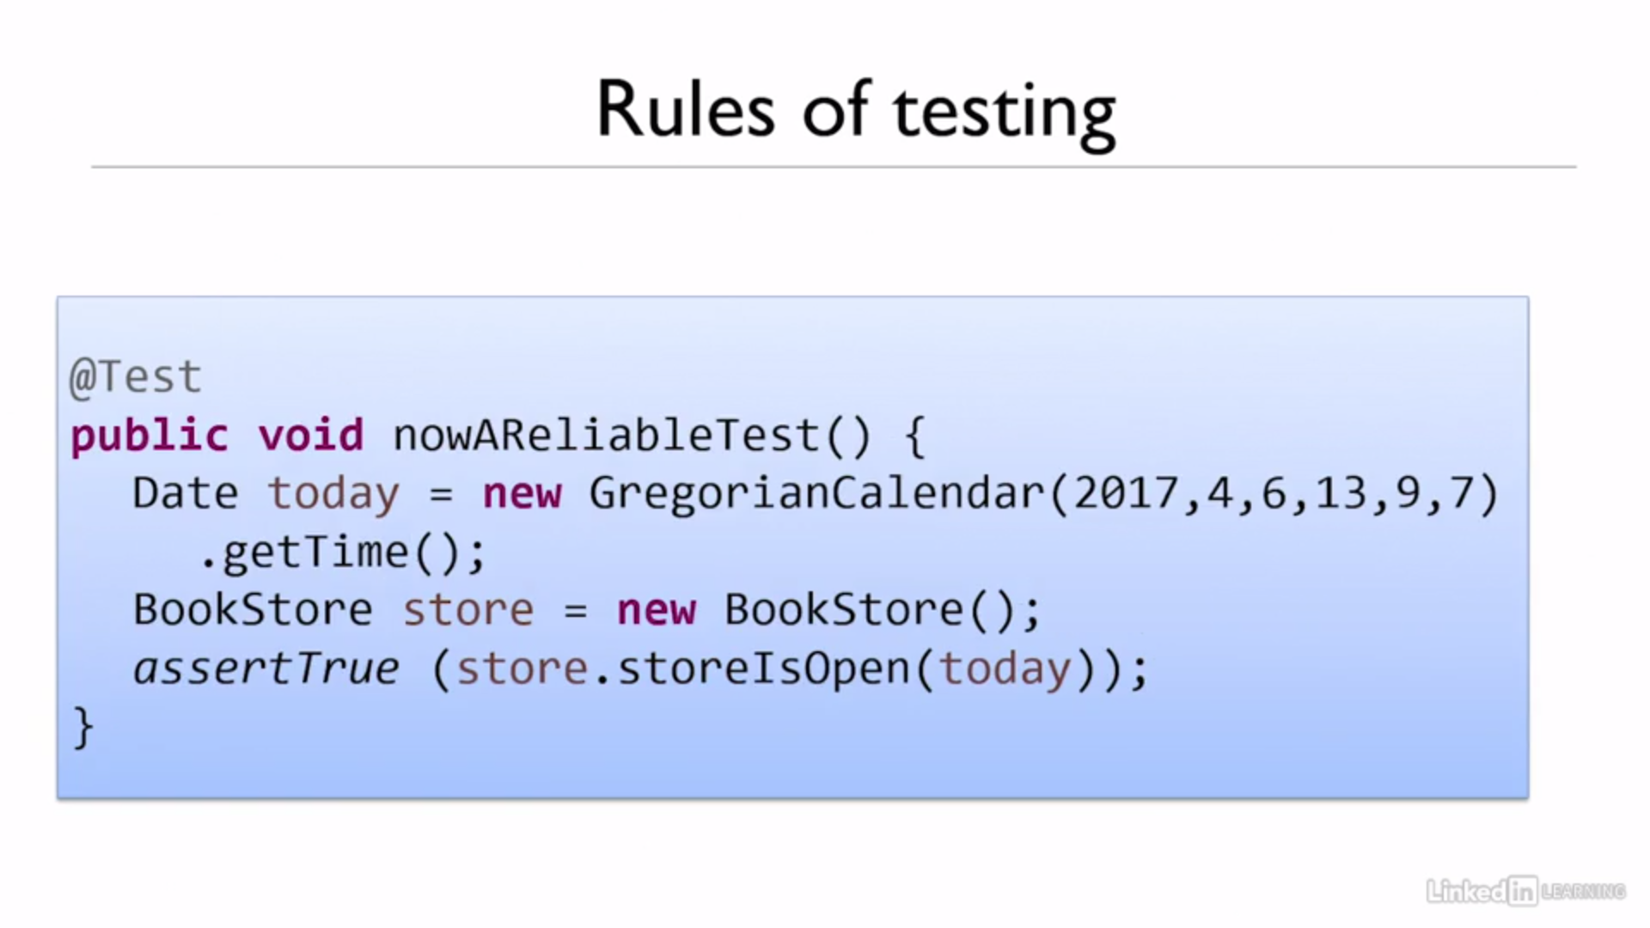

Slide 24
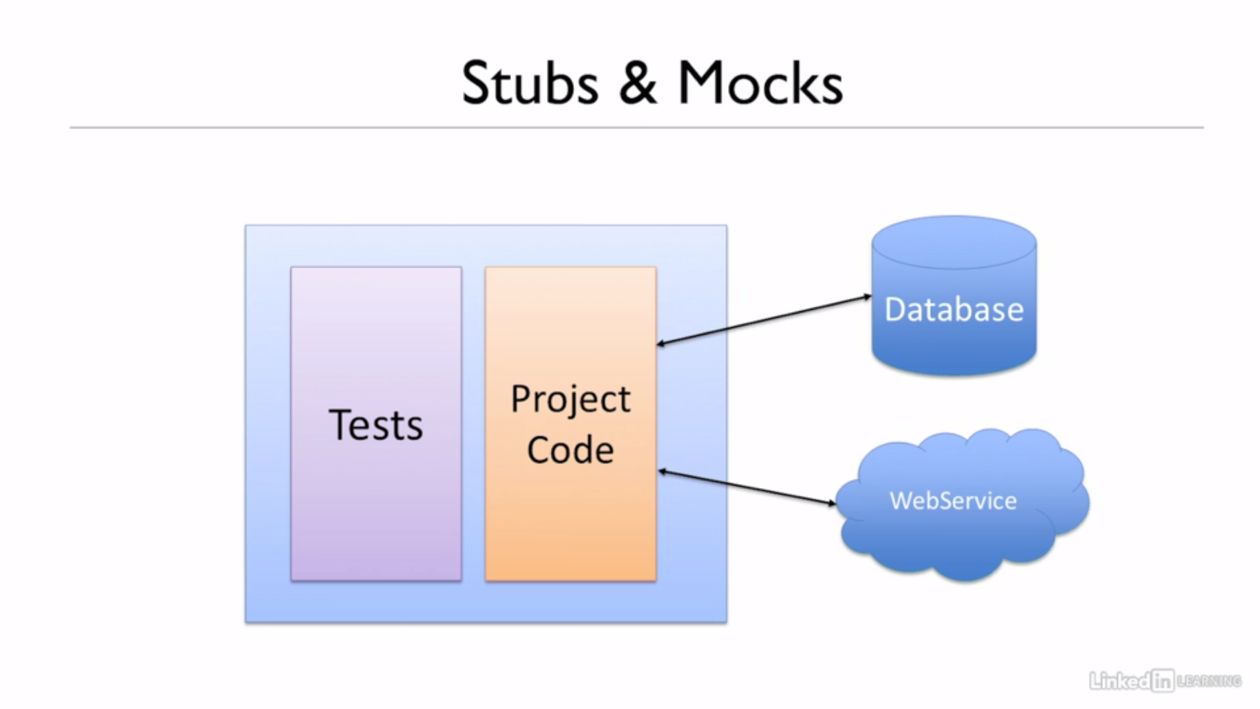

Slide 25
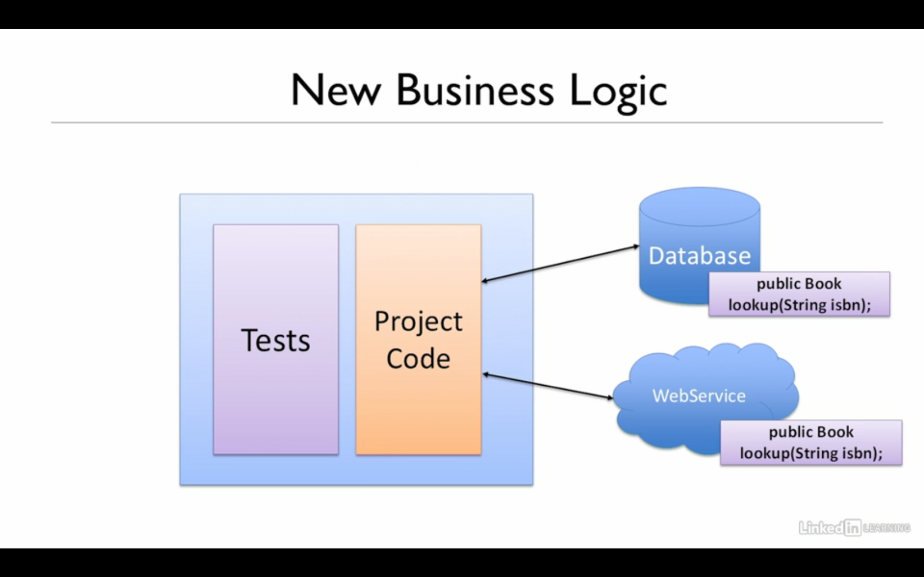
Finding out if a method is called or not is known as testing behavior. Did our code behave in the way that we expected? Did a method we expected to run, actually run? Or did a method we expected would not run, not run? We're testing code flow here, not just did we get the right values out.

Slide 26
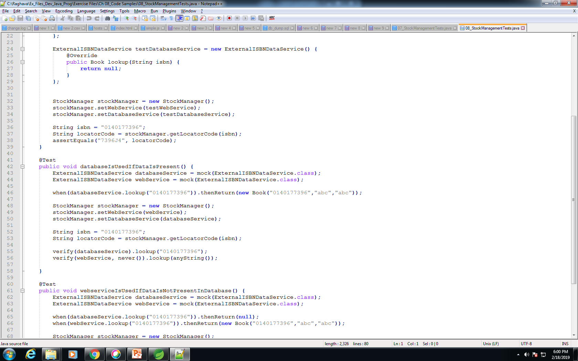
With mocks, we're not actually testing the return values, although of course we could do that as well. What we're really trying to test is whether or not different methods got called.

Slide 27
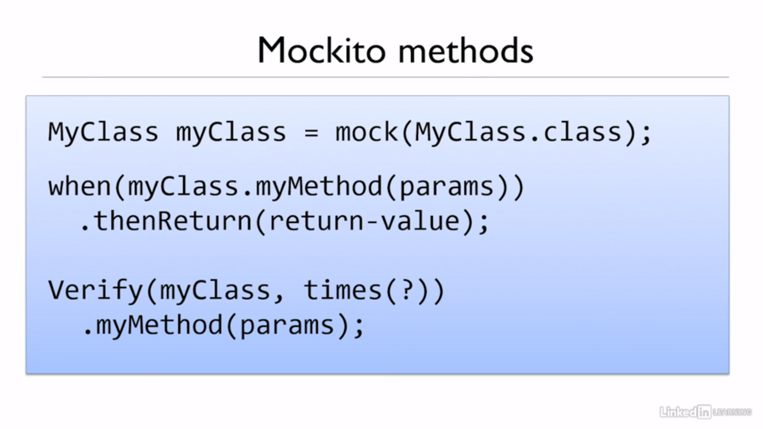

Slide 28
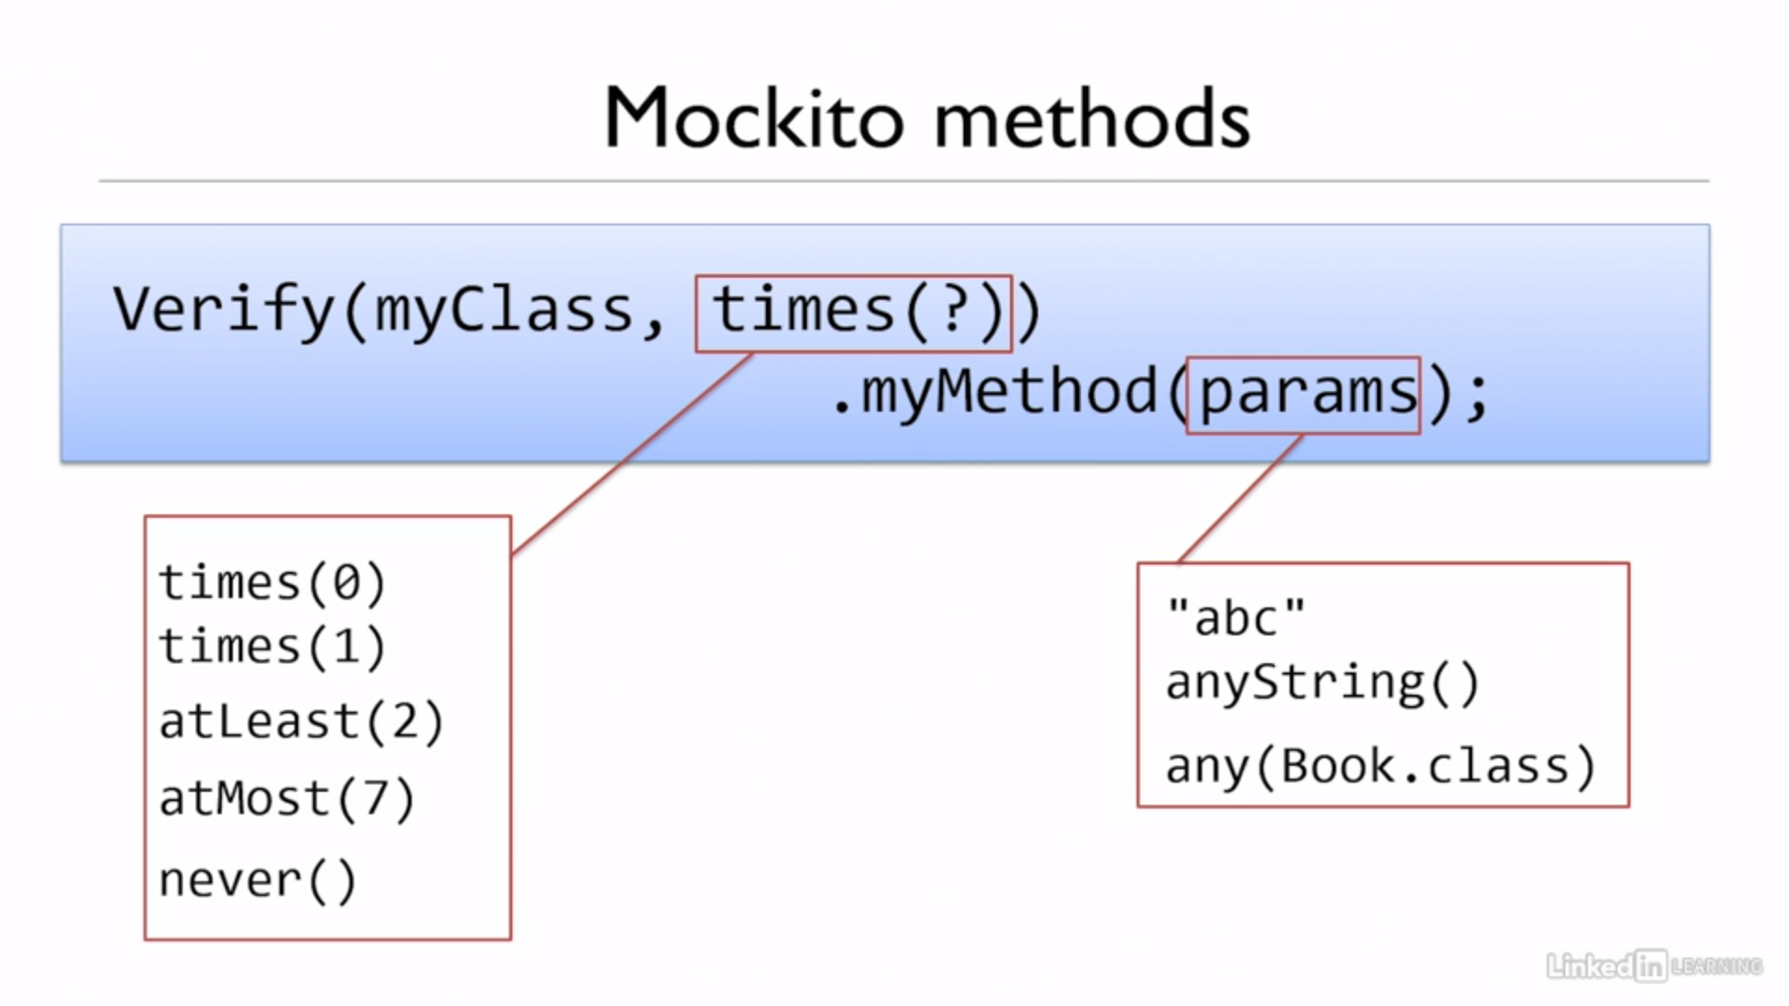
Mockitos

Slide 29
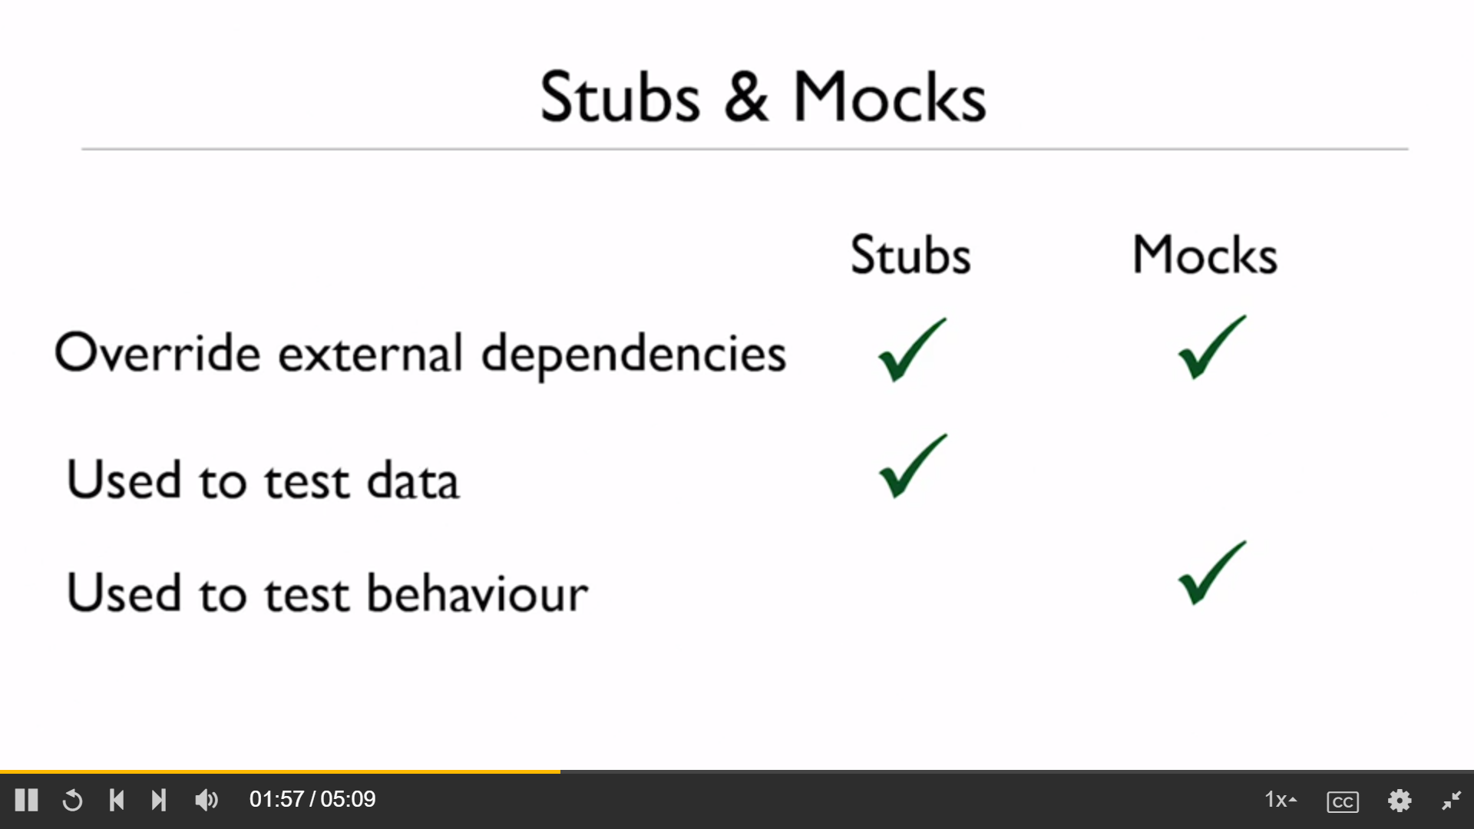
We use stubs and mocks when the code we wish to test has some kind of external dependency that we need to override.
A Stub is a replacement for an object that the clauses we are testing has a dependency on.
There might be some times when you're constrained in your architecture and you can't create this kind of interface. Or there might be times when the interface you need to create is so big and so difficult that actually creating it with the local implementation is a huge amount of work. We need Mocks in such cases.

Slide 30
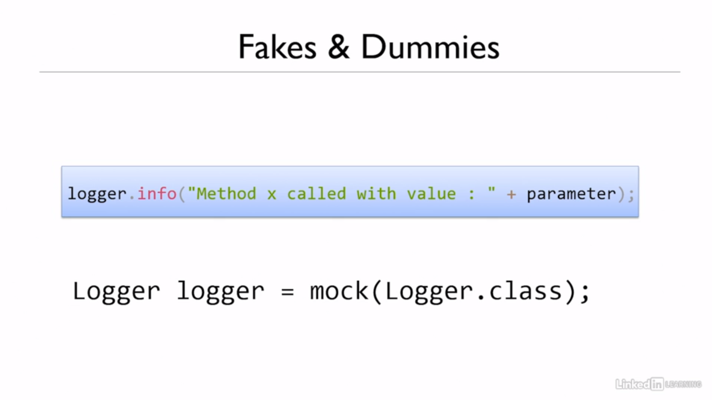
These are even lighter weight versions of stubs. The use case for a fake or a dummy is normally when you need to override something but you have no interest in the thing that you are overriding.
We don’t want the above log not being called in our Unit Tests.

Slide 31
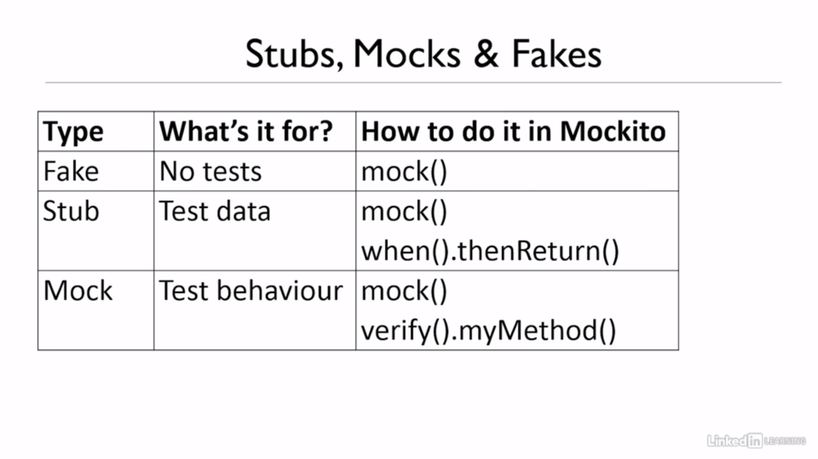
Three levels of objects that we could inject into our code from a unit test.
Notes:
this gives us three levels of objects that we could inject into our code from a unit test.

Slide 32
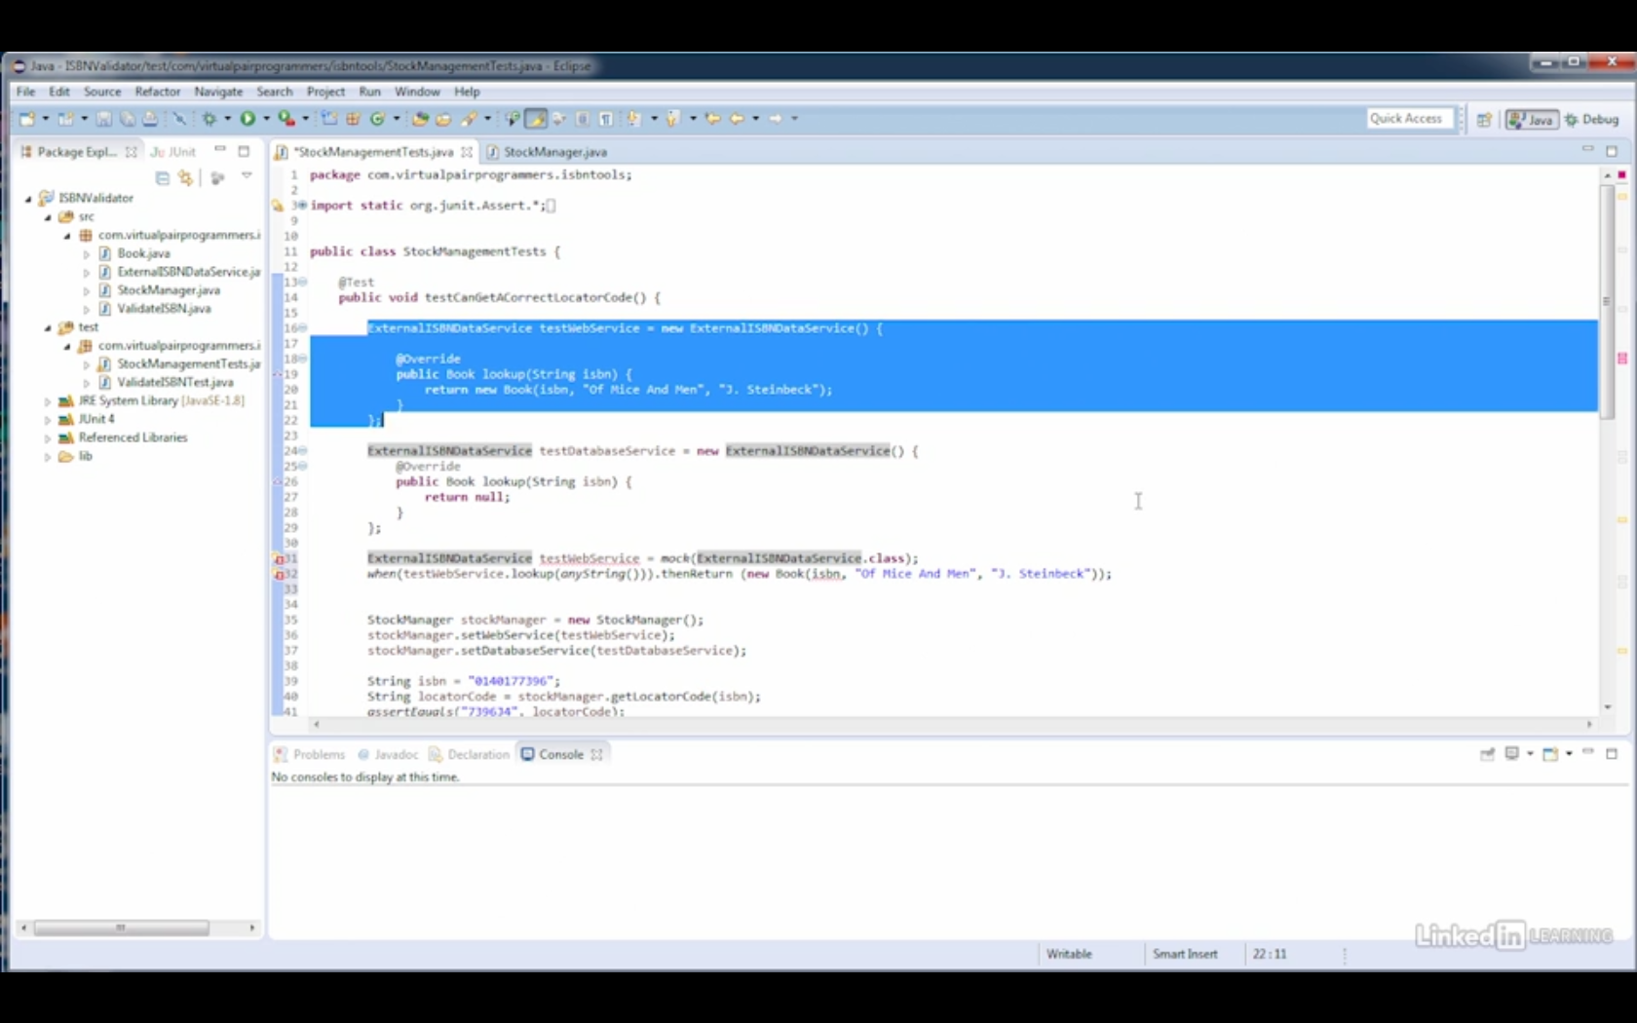

Slide 33
Tautologies
Cause of a bad test, and that is how to avoid tautologies.
A tautology is when you're using the same logic in your test as in your implementation.

